Slide 1
OBD DATA GATHERING – BAKKEN
Automation

Slide 2
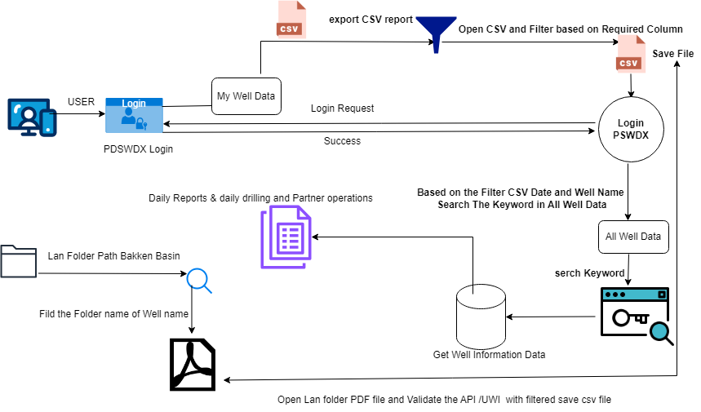
PDSWDX – OBD Data Gathering Workflow Diagram

Slide 3
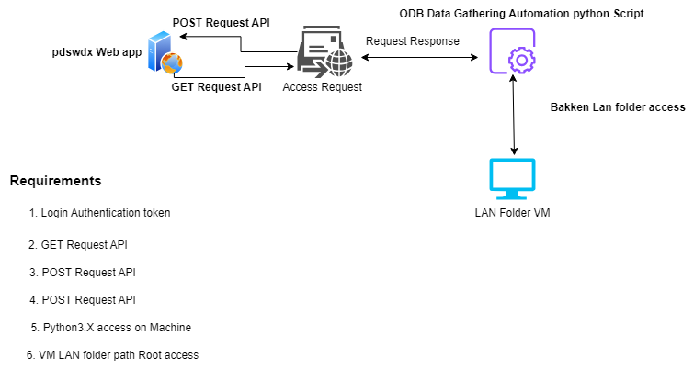
OBD Automation API & Software Requirements

Slide 4
Thank You ..

